Slide 1


KLS's Gogte Institute of Technology
Department of Computer Science & Engineering
Course Name: Block Chain Management
Course Code: 18CS743
Unit IV : Security and privacy
Assistant Professor,
Ravi U. Kalkundri

Slide 2
Introduction
Advances in the digitization of health information, student records, and the like have led to regulations to ensure data privacy for the participants.
The Health Insurance Portability and Accountability Act of 1996 (HIPAA) in the United States provides data privacy and security provisions for safeguarding medical information.
The Family Educational Rights and Privacy Act of 1974 (FERPA) is a federal law that protects the privacy of student education records.
The data records in these systems are typically housed in a centralized database, and its access is controlled by traditional methods such as those listed in the preceding paragraph.

Slide 3
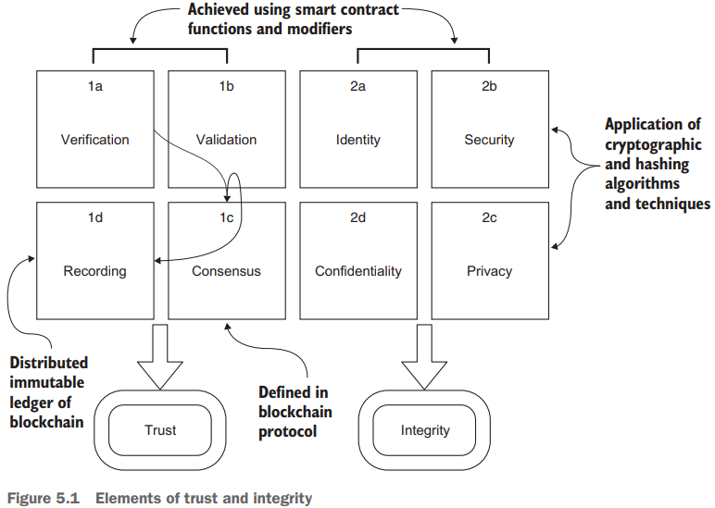
Introduction
Our focus in this chapter will be on addressing identity (2a), security (2b), and privacy (2c) concerns.

Slide 4
5.1 Cryptography basics
Bitcoin and its working cryptocurrency model are based on a strong foundation of cryptographic research and algorithms developed over more than 40 years.
Cryptography plays an indispensable and explicit role in a decentralized blockchain-based solution, in which it is used for
Creating a digital identity for the participants and other entities
Securing data and transactions
Ensuring the privacy of data
Signing documents digitally

Slide 5
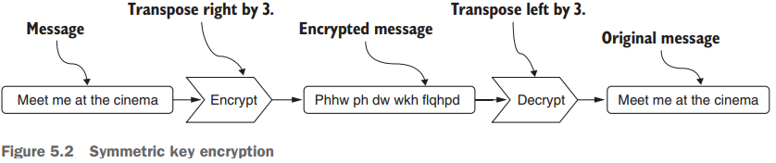
5.1 Cryptography basics
5.1.1 Symmetric key cryptography
Let’s start by taking a quick look at Symmetric key cryptography so you understand the encryption process and also why this method may not be suitable for decentralized applications.
It’s called symmetric key encryption because the same key is used for encryption and decryption.
Let’s examine the common Caesar encryption: the individual letters of a message are alphabetically shifted by a fixed number (key).
You shift every letter by 3 to encrypt it; the receiver of your message decrypts it by using the same “key” and shifting each letter the other way by 3 to view the original message.

Slide 6
5.1 Cryptography basics
5.1.2 Asymmetric key cryptography
Asymmetric key cryptography is commonly known as Public-key Cryptography.
This method uses two different keys instead of a single secret key (as in symmetric key cryptography):
Let {b, B} be {private key, public key} for a participant in Buffalo, New York, USA.
Let {k, K} be the key pair for a participant in Kathmandu, Nepal.
Each participant publishes their public key but keeps their private key safe and secure, typically using a passphrase.
Either participant can use the other’s public key to encrypt a message that only that other person can decrypt, using the corresponding secret private key.

Slide 7
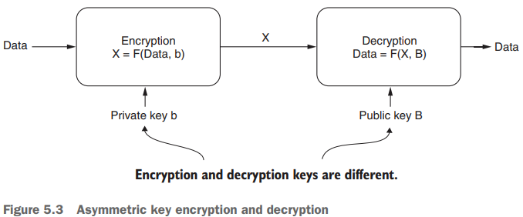
5.1 Cryptography basics
5.1.2 Asymmetric key cryptography
The key pair works as shown in figure 5.3. Input data (Data) is encrypted using function F and secret private key b, resulting in encrypted message X.
The message X is decrypted using the same function F, but now with a different key—public key B—to extract the original data.
Thus, the public-private key pair has a unique property: when a message is encrypted with the private key, it can be decoded with the public key, and vice versa.
The encryption and decryption keys are not the same; thus, the method is asymmetric.

Slide 8
5.2 The relevance of public-key cryptography to blockchain
Public-key cryptography is used for a range of operations on the blockchain, from account address generation to transaction signing.
5.2.1 Generating Ethereum addresses
There are two types of accounts in Ethereum: Externally Owned Accounts (EOAs) and Smart Contract Accounts.
Have you ever wondered how these account addresses (identities) are created?
How is it that they are unique for the participants in the chain?
To address these concerns, Ethereum uses a mechanism based in public-private key pairs to generate account addresses.

Slide 9
5.2 The relevance of public-key cryptography to blockchain
5.2.1 Generating Ethereum addresses
Here is a high-level description of the mechanism:
A 256-bit random number is generated and designated as the private key.
A special algorithm called the elliptic curve cryptography algorithm is applied to this private key to derive a unique public key. These two form the {private, public} key pair; the private key is secured by a password, and the public key is open to the world.
A hashing function, RIPEMD160, is applied to the public key to obtain the account address:
This address is shorter than the key: 160 bits or 20 bytes. This address is the account number you see in Remix and the Ganache environment and can be used as an address on a public blockchain network.
The address is represented in hexadecimal for easy readability, as indicated by the 0x as the first two characters, as in the example 0xca35b7d915458ef540 ade6068dfe2f44e8fa733c.

Slide 10
5.2 The relevance of public-key cryptography to blockchain
5.2.2 Transaction signing
The cryptographic key pair is also used for Tx signing.
The private key is used in the process of digitally signing transactions for authorization and authentication.
Recall that in chapter 4, you used MetaMask to confirm your Txs. One of the operations performed at that time by MetaMask is signing the Txs by using your private key.

Slide 11
5.2 The relevance of public-key cryptography to blockchain
5.2.3 Deploying smart contracts on Ropsten
So far, you’ve been developing smart contracts and Dapps and deploying them on a test chain, such as the Remix IDE’s JavaScript VM or the Ganache local test chain, to gain experience in a controlled environment.
Ropsten is a public test network that implements the Ethereum blockchain protocol.
Ropsten is ideal for experimenting with your deployment after completing initial tests in Remix and other test networks.

Slide 12
5.2 The relevance of public-key cryptography to blockchain
5.2.3 Deploying smart contracts on Ropsten
Before you deploy on Ropsten, you’ll need a few items to set up the environment:
A wallet for managing accounts and signing transactions. You can use MetaMask to manage your Ropsten accounts.
A method for populating this wallet with a deterministic set of test account addresses.
A Ropsten faucet for depositing test ether into the accounts for Tx execution and ether transfer among peer participants.
The Remix IDE’s injected web3 environment for supporting the Ropsten accounts through MetaMask and interacting with the smart contract through its user interface.
A smart contract ready to be deployed on the Ropsten network.

Slide 13
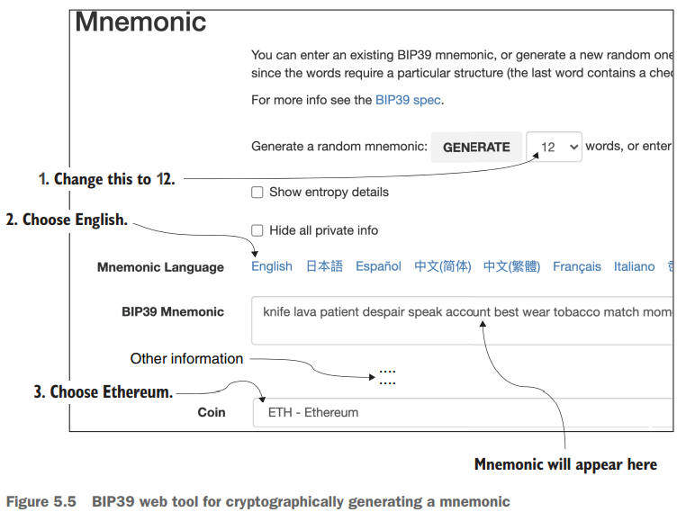
5.2 The relevance of public-key cryptography to blockchain
5.2.4 Using the private key in mnemonic form
The 160-bit account addresses are cryptographically generated from the 256-bit private-public key pair.
You need this private key every time you want to generate/recall your account addresses.
It is simply impossible for you to remember this private key. Instead, a mnemonic is used to represent the private key.

Slide 14
5.2 The relevance of public-key cryptography to blockchain
5.2.5 Populating a blockchain wallet
Let’s use the cryptographic key pair to generate a wallet so that we can operate on a public blockchain by generating the accounts from the mnemonic copied from the BIP39 tool and by collecting ether as deposits in the accounts.
Here is a way to use the cryptographic mnemonic :
Open the Chrome browser where MetaMask is installed, and connect to Ropsten by choosing Ropsten Test Network from the Networks drop-down list.
Click Import, using the account seed phrase, and in the text box that opens, enter the mnemonic you generated in section 5.2.4. This interface requires a password; enter the password twice and then click the Restore button.
To create any number of accounts, click the Create Account button in MetaMask; copy one of the new account addresses that shows up to the clipboard. This account is a valid account of the Ropsten network. You’ll notice that you have 0 ether balance.
Use the copied address to receive the test ether from a Ropsten faucet tool as shown in the next two steps.

Slide 15
5.2 The relevance of public-key cryptography to blockchain
5.2.5 Populating a blockchain wallet
To work on Ropsten, you need to receive some test ether, which you can do by accessing any Ropsten faucet.
Follow these steps:
In your browser, navigate to the Ropsten faucet page (https://faucet.ropsten.be), shown on the left side of figure 5.6.
2 Paste in the address you created in MetaMask and copied to your clipboard, and then click the Send Me Test Ether button. After a short time, you’ll receive 1.0 ether credited to the MetaMask account you created.Open the Chrome browser where MetaMask is installed, and connect to Ropsten by choosing Ropsten Test Network from the Networks drop-down list.

Slide 16
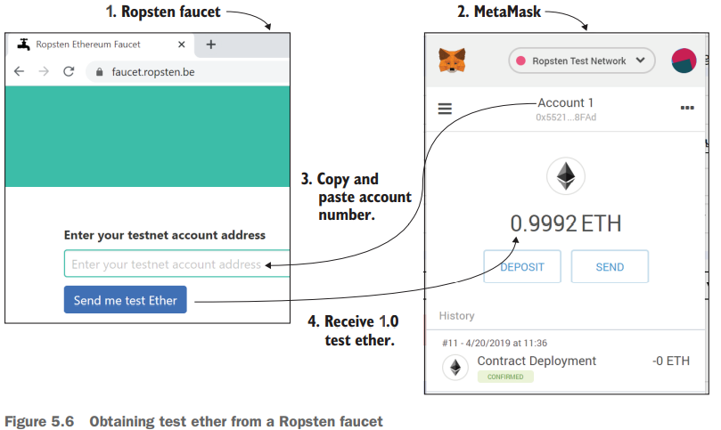
5.2 The relevance of public-key cryptography to blockchain
5.2.5 Populating a blockchain wallet
You can get 1 ether every 24 hours on this particular faucet, which is sufficient for making the initial deployment and learning about this public test blockchain.
You’ll have to repeat this operation to get more ether.

Slide 17
5.3 Hashing basics
Hashing is a transformation that maps data of arbitrary sizes to a standard fixed-size value.
The hash of data elements are computed by using a hash function, as shown here:
hash = hashFunction(one or more data items)
Using a logical XOR (exclusive OR) function as a simple hash function and two data items of a =1010 binary, b= 1100 binary, you get the hashed value of the two data items as 0110:
hash value = xor(a=1010, b=1100) = 0110
DEFINITION Hashing is the process of mapping data of an arbitrary length to a fixed size by using a specially defined function called a hash function.

Slide 18
5.3 Hashing basics
Even a single bit change in the data elements changes the hash value of the data elements significantly.
Any type of data, including a database or an image, can be succinctly represented by a hash of fixed length, as shown in figure 5.9.
A 256-bit data item and a strong hash function together provide a large, collision-free account address space.
Collision-free means there is a high probability that no two values generated by the hash function will be the same and that you’ll get a unique hash value when you apply the hashing function to the same data elements.

Slide 19
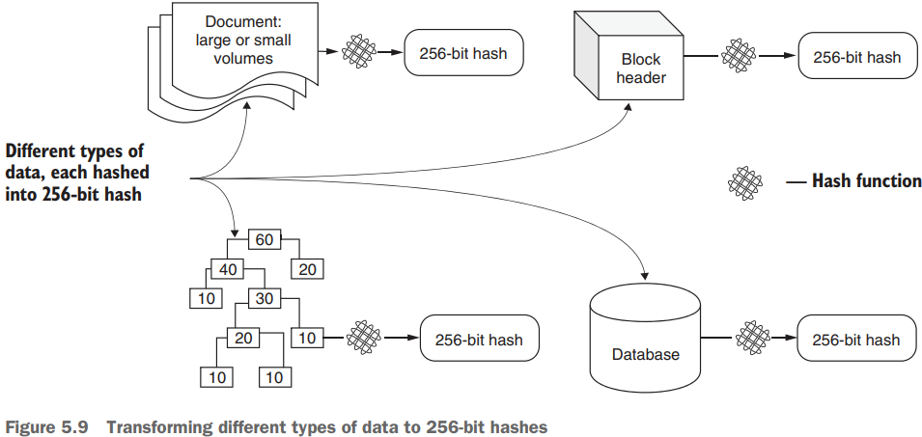
5.3 Hashing basics
Figure 5.9 shows a hash of fixed length:

Slide 20
5.3 Hashing basics
5.3.1 Digital signing of documents
For the digital signing of a document, a hash function is used to compute a hash of the document.
This hash is used as the digital signature for the document and attached to the document by the sender.
This signature can be verified later by the receiver of the document by recomputing the hash of the document and comparing it with the attached digital signature (hash).

Slide 21
5.3 Hashing basics
5.3.2 Hashed data on distributed ledger
Blockchain is not your regular database; it stores only the minimal data needed in its distributed ledger.
Hashing helps here too! The blockchain isn’t overloaded by a large document because only the hash value (representation) of the document can be stored on the chain.

Slide 22
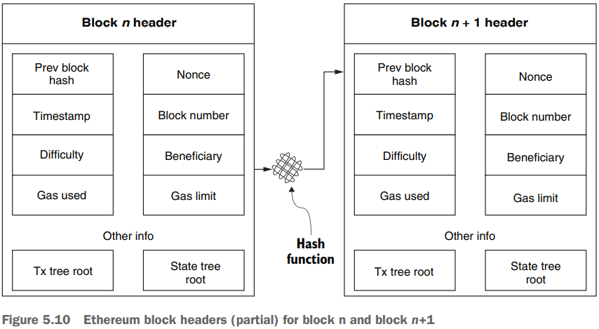
5.3 Hashing basics
5.3.3 Hashes in Ethereum block header
The blockchain is a tamperproof immutable ledger consisting of blocks that contain records of transactions, mutable state, logs, return values (receipts), and many other details, as shown in the Ethereum block header diagrams in figure 5.10.

Slide 23
5.3 Hashing basics
5.3.3 Hashes in Ethereum block header
Txs, state, logs, and receipts are stored in a Merkle tree (trie) data structure, and the hash of this tree is stored in the header.
The header also stores a hash of the previous block’s header, forming a link to the previous block, constructing the chain, and enforcing immutability.
Even a single bit change in the block’s contents will change its hash significantly, thus breaking the chain; so as you can see, the block hashes are instrumental in realizing the immutability and integrity of the chain!
Hashing is a core component of the consensus process for deciding the next block to be appended to the chain.
Hashing is also a recommended pre-processing step for encryption of messages and digital signing of transactions.
It plays an important role not only at the protocol level, but also at the application level.

Slide 24
5.3 Hashing basics
5.3.4 Solidity hashing functions
Three hashing functions provided by Solidity:
SHA256
Keccak (also a 256-bit hash function), and
RIPEMD160 :
RIPEMD160 is used in the generation of a 160-bit account address from the 256-bit public key of an Ethereum account.
Keccak was developed for Ethereum based on the SHA3 (secure hash) algorithms.
You’ll use Keccak as your hash function for Dapp development because it was implemented for the Ethereum blockchain before SHA3 was finalized as a standard.

Slide 25
5.4 Application of hashing
PROBLEM STATEMENT:
A beneficiary plans a blind auction for a piece of artwork. There may be many pieces to be auctioned off, but for this problem, you’ll consider only one; you can always add others after this piece is sold. The beneficiary controls the various stages of the auction, {Init, Bidding, Reveal, Done}. After initiation by the beneficiary, the bidders bid one bid at a time during the Bidding phase, providing their bids securely and privately. Others, including the beneficiary, cannot see what each bid is. After a while, the beneficiary advances the stage to the Reveal phase. Now bidders openly send their bids, and the beneficiary opens the bids and identifies the highest bidder and highest bid. The beneficiary ends the auction by advancing the stage to Done, at which time the auction ends. The highest bid value is transferred to the beneficiary account. Nonwinner bidders can withdraw their deposits, and the winning bidder is returned the balance of their deposit.

Slide 26
5.4 Application of hashing
5.4.1 Blind auction design
Let’s study the problem and apply the design principles (DPs).
DP 2 and DP 3 are used to guide you in defining the data structures.
using a contract diagram (DP 4), you’ll represent the design by
The auction state transitions by using a finite state machine (FSM; DP 5).
Use modifiers for any rules (DP 6) to be implemented by the smart contract.
Applying the DPs provides a structured approach to starting blockchain solution development.

Slide 27
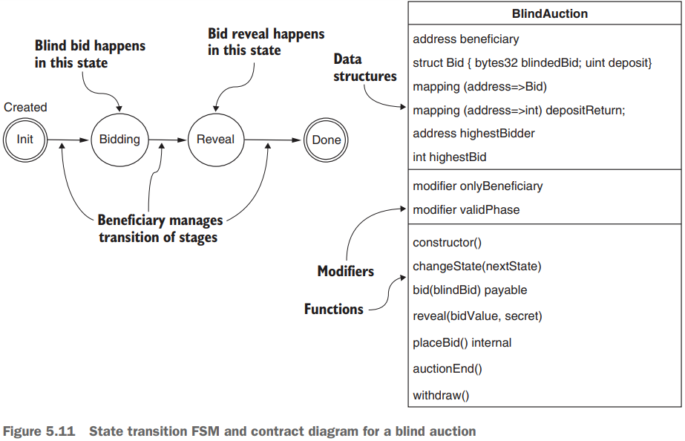
5.4 Application of hashing
Problem similar to the states in the Ballot-Dapp.
After all the DPs are applied, the contract diagram and the state transition diagram are as shown in figure 5.11..

Slide 28
5.4 Application of hashing
5.4.2 Blind auction smart contract
The smart contract for the blind auction is a modified version of the code in the Solidity documentation, enabling us to focus on privacy and security concerning only one item: blindedBid.
Let’s review the code and then use the Remix IDE to test the smart contract. You can copy the listings to the Remix IDE as directed and explore it.
Let’s look at the following:
Data elements
Modifiers
Functions
The data elements include data for the bid, an enumerated data type for the phases (states) of the auction, the beneficiary address, mappings for bids and deposit returns, and the highest bid details.

Slide 29
5.4 Application of hashing
5.4.3 Privacy and security aspects
During the Bidding phase, bidders place blind bids; thus, the contents of the bids (values) are private as well as secure.
How do you guarantee privacy and security?
You can achieve privacy by hashing the parameters.
But although a hash may appear to human eyes to be indecipherable, it can be broken by brute force.
The Keccak hash for the integer value (uint) 20, for example, is the same whether you’re on the Earth, Moon, or Mars, in Lagos (Nigeria), or New York (United States), as follows:
0xce6d7b5282bd9a3661ae061feed1dbda4e52ab073b1f9285be6e155d9c38d4ec

Slide 30
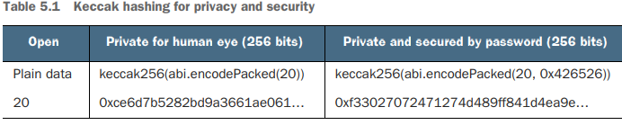
5.4 Application of hashing
5.4.3 Privacy and security aspects
This 32-byte hash value might look like gibberish to you, but a brute-force attack with knowledge of the approximate context and value of the auction item could easily decipher the bid value if so desired.

Slide 31
5.4 Application of hashing
5.4.4 Testing the BlindAuction contract
You’ll need a test plan (as discussed in chapter 3) to explore the operation of the smart contract code for the blind auction. Let’s assume the following as preparation before testing:
You need at least three participants: the beneficiary and at least two bidders. Let’s choose the first three accounts of the Remix IDE: account[0], account[1], and account[2], with addresses that begin with 0xca3..., 0x147…, and 0x4b0…, respectively. You have to choose account[0], account[1], and account[2] from the drop-down list in the Remix simulated environment.
account[0] will be the beneficiary, the one that deploys the smart contract, and the only one that can change the phase of the auction. For account[0], I’ve used the address 0xca3….
account[1] and account[2] will be the two bidders for testing purposes. I used 0x147.. for account[1] and 0x4B0.. for account[2].
account[1] will place a blind bid of 20 with a deposit (value) of 50 wei, and account[2] will place a blind bid of 30 with a deposit of 50 wei.

Slide 32
5.4 Application of hashing
5.4.4 Testing the BlindAuction contract
You’ll need a test plan (as discussed in chapter 3) to explore the operation of the smart contract code for the blind auction. Let’s assume the following as preparation before testing:
The secret one-time password or the secret is 0x426526; the 0x indicates hexadecimal notation. You need the entire 32 bytes when entering it in the Remix UI. Here it is:
0x4265260000000000000000000000000000000000000000000000000000000000
The bid is computed by the Keccak function Keccak256(abi.encodedPacked(v, secret), where v=20 for account[1] and v=30 for account[2]. For your convenience, I provide the 256-bit password and the encoded values for 20 and 30 at the bottom of BlindAuction.sol. You can easily copy and paste when transacting in the Remix IDE.

Slide 33
5.4 Application of hashing
5..4.5 Test plan
Here is a minimal test plan (refer to figure 5.12 to follow along):
Bidding phase. From account[1], set the value (top-right panel of figure 5.12) to 50 wei. Specify the first blind bid value of 20 as 0xf33027072471274d489ff841d4ea9e7e959a95c4d57d5f4f9c8541d474cb817a as the parameter for the bid() function, and click Bid. Repeat the process for account[2], but with the second blind bid value of 30 as 0xfaa88b88830698a2f37dd0fa4acbc258e126bc785f1407ba9824f408a905d784 as the parameter. Now the Bidding phase is over.
Reveal phase. From account[0], the beneficiary account, enter 2 as the parameter for the changeState() function, and click the ChangeState button. Click the button for the state public variable to make sure that the value is 2 for the Reveal phase. From account[1], enter 20, 0x4265260000000000000000000000000000000 000000000000000000000000000 as parameters for the function reveal(), and click Reveal. Now click the HighestBidder and HighestBid buttons to check that they’re correct. You’ll see account[1]’s address and a bid of 20. Repeat the reveal from account[2] but with 30, 0x4265260000000000000000 000000000000000000000000000000000000000000 as parameters. Then click the HighestBidder and HighestBid buttons again to verify that the bid of 20 has been knocked off by account[2]’s bid of 30. The Reveal phase is over.

Slide 34
5.4 Application of hashing
5..4.5 Test plan
Here is a minimal test plan (refer to figure 5.12 to follow along):
Done phase. From account[0], the beneficiary account, enter 3 as a parameter for the changeState() function; then click ChangeState. Click the button for the state public variable to make sure that the phase is Done. Now you can click the auctionEnd() button to pay the beneficiary the highestBid amount.
Check out the winner. Click the HighestBidder and HighestBid buttons again to find the winner’s values.
withdraw() function

Slide 35
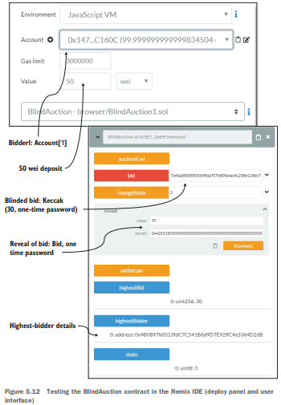
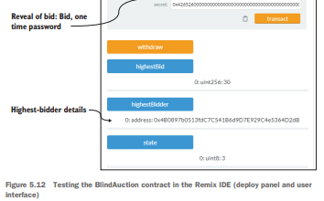
5.4 Application of hashing
5..4.5 Test plan

Slide 36
Thank You

Slide 37
From smart contracts to Dapps

